Slide 1

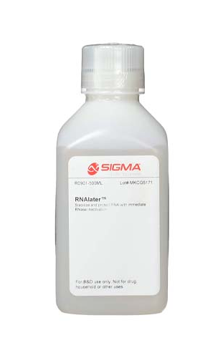
Sample types, RNA extraction and library preparation
Porto, 16th & 17th March 2023

Slide 2

Start with highest quality freshest material possible
Use TRIzol, column or bead based extraction system
DNase treat the sample
Check for contamination
Clean up any contamination (e.g. guanidinium or phenol) with secondary column or bead purification
Accurately quantify RNA
Assess quality of RNA
Congratulate yourself... The easy bit is done

Slide 3
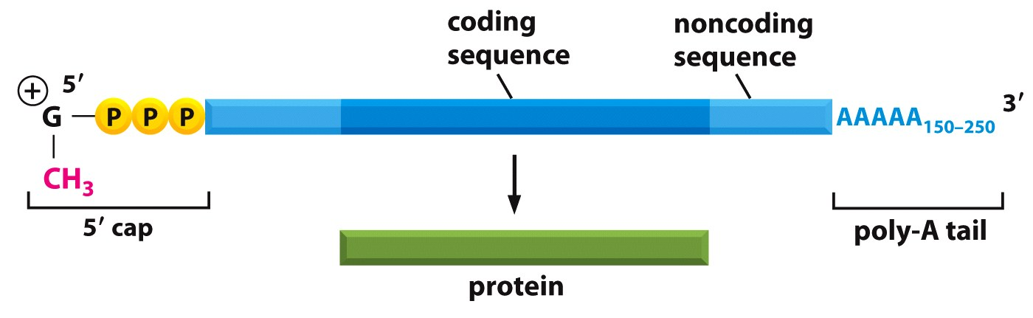
RNA...
rRNA ~ 80% ribosomal mass in a cell
mRNA ~ 1-5% ribosomal mass in a cell
Figure 7-10 Essential Cell Biology (© Garland Science 2010)
mRNA is short lived
Cell | Cell generation time | Average mRNA half life | Range of mRNA half lives
Escherichia coli | 20 – 60 min | 3 – 5 min | 2 – 10 min
Sacchromyces cerevisiae | 3 hr | 22 min | 4 – 40 min
Cultured mammalian cells | 16 – 24 hr | 10 hr | <30 min - 24 hr

Slide 4

RNA degradation – magic and mystery
Degradeio!?!
RNAse
Physical / chemical...
RNA can degrade in solution through hydrolysis, a process enhanced by heat and high pH.
Ribonucleases
RNAses are enzymes that directly and rapidly degrade RNA.
Remain active at -20 °C.
Exist virtually everywhere.
RNAses are a very common justification for degraded RNA...
Degredation only usually occurs when good practice is missing
(no magic or mystery involved!).
Practice + Being aware of your sample and processes will prevent most RNAse issues.

Slide 5
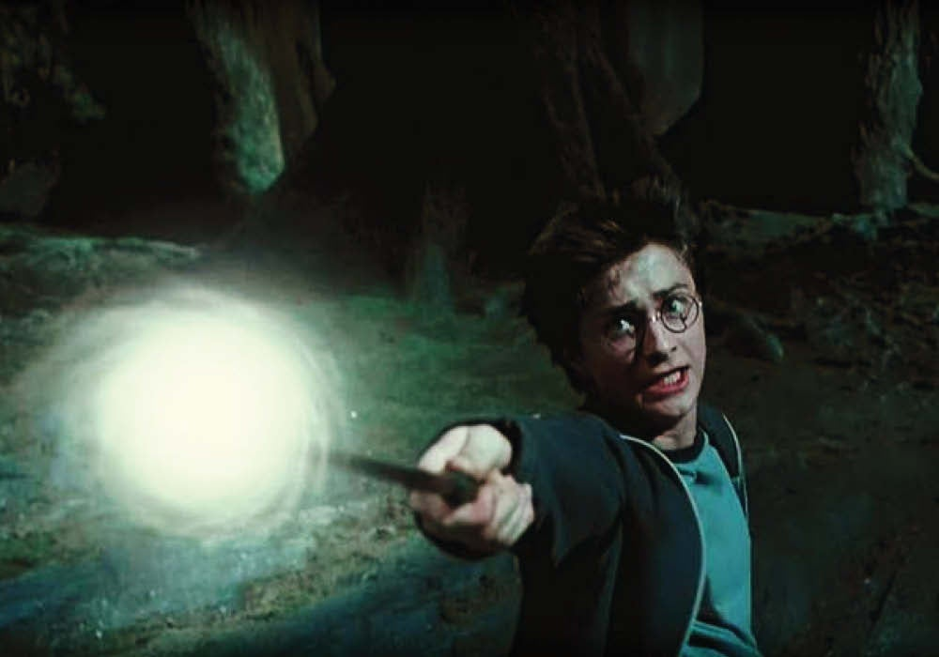
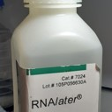
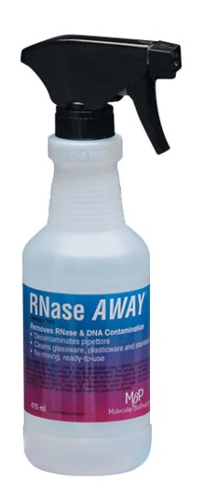
RNA protection – magic and mystery
Protego
The majority of RNases that will cause you issues exist within the sample... They are a normal part of cellular function.
Preserve you sample as soon as possible.
Other RNases exist on you and in the lab...
Always operate good practice in the lab.
Keep things clean and cold.
Work quickly.
Don’t freeze-thaw more than you need to!
Use RNase away / RNase zap as a last resort.
It destroys enzymes indiscriminately and is thus not beneficial for the majority of lab work!

Slide 6
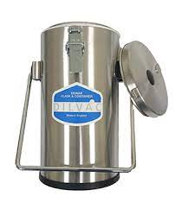
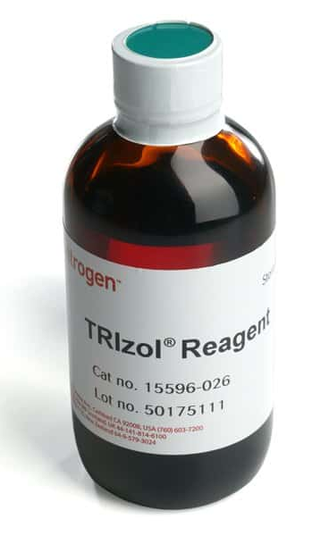
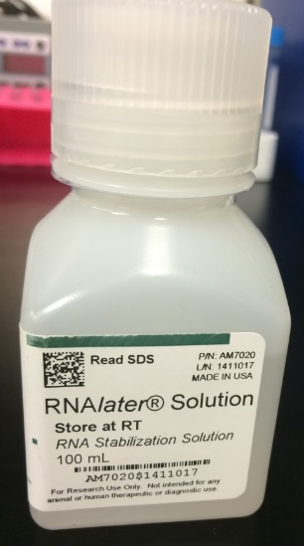
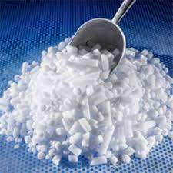
Sample Collection
Sample collection methods should be optimised and tested to suit your sample type, size and lab situation
Clean equipment, scalpels, forceps etc with ethanol.
Excise tissue – if contaminated (e.g. blood) wash with RNAse free water
Flash freezing in liquid nitrogen. (greatest flexibility)
Flash freeze in supercooled isopentane (allows for greater control and freezing of larger samples).
Flash Freeze tissue in tube on dry ice.
Fix and Store in RNAlater. (safest)
Allow the sample to fix overnight.
Fix and Store in TRIzol (limits later options)
Sample should be homogenised for effective fixation.
Quantities required are hugely dependent on type of tissue and experiment, but generally speaking keep pieces of tissue to less than 3mm^{3.} Always take extra samples as backup and for testing methods.

Slide 7
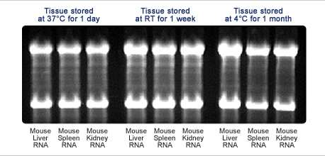
Sample storage
Directly Frozen tissue
Always store tissue at -70 °C or lower
Transfer tubes on dry ice or LN2.
-20 °C very limited scope for storage – samples will degrade rapidly.
Cannot go through freeze-thaw cycles without issue
RNAlater
Fixative – requires time to fix samples.
Functions for 1 day at room temp, 1 month in a fridge, 1 year at -20, a long time at -80.
Freeze thaw cycles are possible but eventually reduce integrity and varied between tissues.
RNAlater also good for storing DNA...

Slide 8
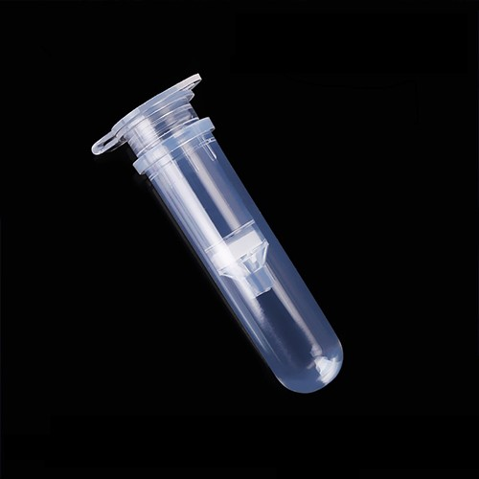
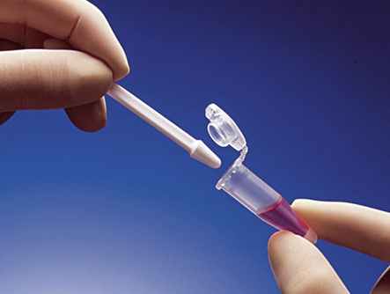
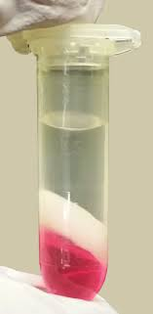
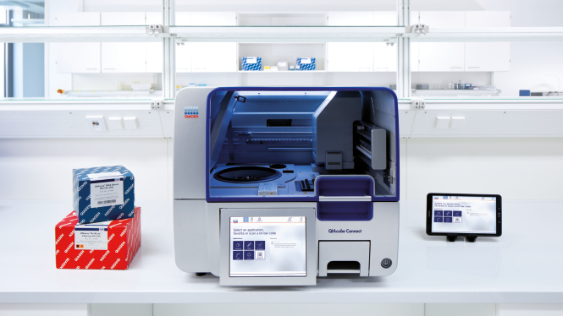

RNA extraction
Multiple options for RNA extraction.
Most important is to check the process on mock samples before starting on actual samples.
Stabilize > Lyse > Collect RNA > Remove DNA > Clean RNA > Elute RNA> re purify as required
Trizol /TriReagent/ Tripure - phenol and guanidinium isothiocyanate
Column based extraction / cleanup
Bead based extraction / cleanup
Automated (Robot) extraction (generally just automated column or bead)

Slide 9

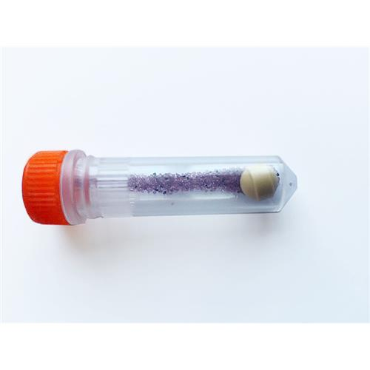
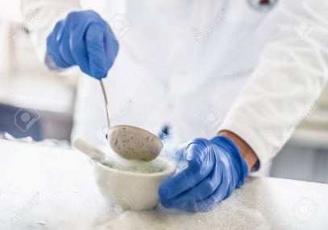
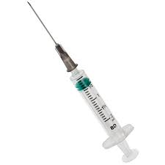
RNA extraction
Effective homogenisation and cell lysis is crucial. LOOK at the samples
MpBio fastprep is very useful. Easy, scalable, quick, effective.
Use liquid nitrogen pestle and mortar for large samples.
Pellet pestle for medium small samples.
Pass through syringe to remove clumps (if necessary)
For tricky samples some material will never homogenise (pearls / scales)
Spin down homogenate in lysis buffer and separate supernatant from cell debris.
Remove DNA with DNase step during extraction.

Slide 10
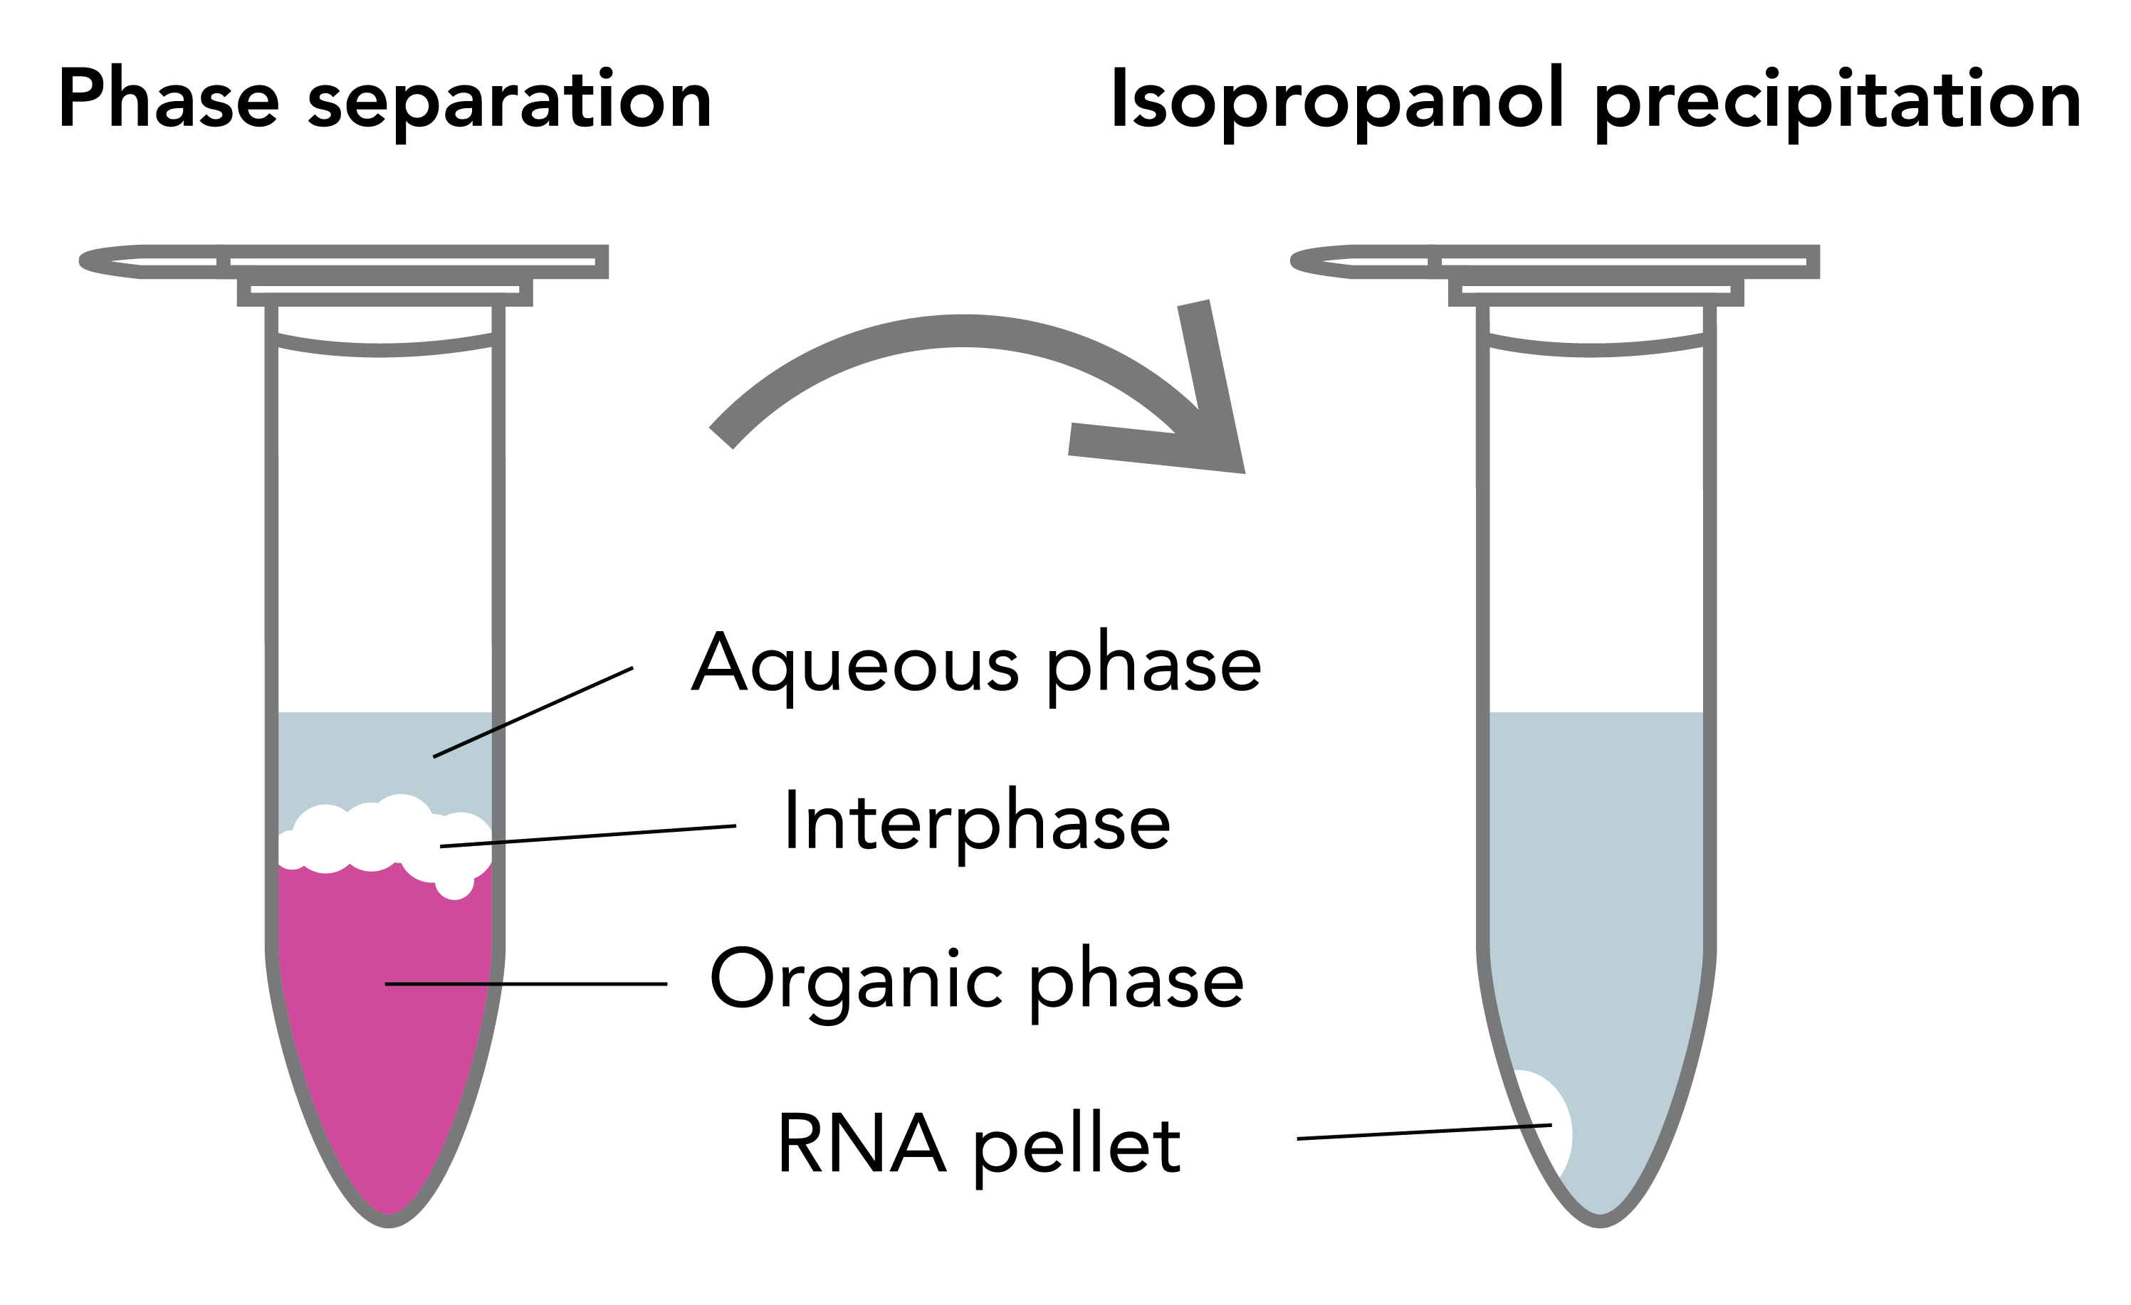
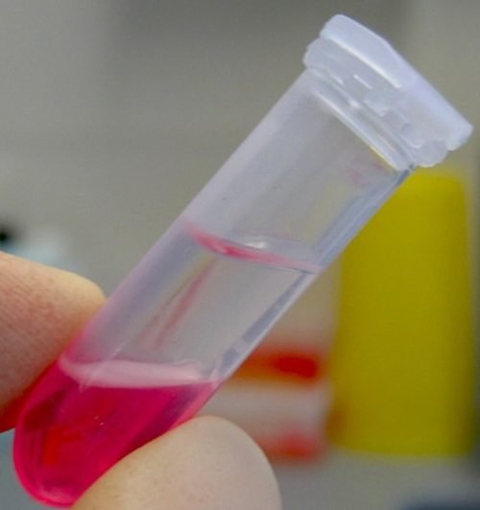
TRIzol
Effective on most tissues.
Large RNA yields
Time consuming.
Dangerous Chemicals (phenol will burn skin and eyes).
TIPS...
USE TEST SAMPLES FIRST to check required quantities.
The most common mistake is using too much starting material.
Always look at the tube! Use your (goggle protected) eyes.
Too much material = messy interphase.
Use less, clean the aqueous again (take aqueous phase, add more chloroform (or BCP), mix, spin and collect).
Only use clean aqueous phase... less is more.
Work with smaller numbers of samples and work quickly.
Aqueous phase
Interphase
Inorganic phase

Slide 11
Extraction kits (Qiagen / Promega etc etc)
100s of Kits available for specific cell / tissue types.
Same principles apply...
Lysis protocols / reagents in these kits are designed for classic tissues (mouse liver, spleen, heart etc)
Good quality lysis is crucial. Practice, observe and
Less material is generally better than more material.
Can often be automated.
TIPS
Most common problem is too much starting material... Remember to optimise.
If lysis looks messy dilute samples in more lysis buffer and use half.
OR... Spin lysate and only use the supernatant.
Tissue lysed in RLT (or equivalent buffer) is safe to be stored at -80°C.
Work with small numbers of samples and keep things cold.
Simple kits will almost always work when you have good lysate.
Don’t waste money on specialist extraction kits.
Spend time optimising lysis.

Slide 12
Other comments...
Columns and beads can be used for total extraction, to purify RNA that has come contamination, to clean up the aqueous phase from a TRIzol extraction.
RNA can be cleaned again.
Be consistent. Use the same protocol for a whole experiment. For example different methods can result in differential size selection which may prove important.
Always remove DNA with DNase step during or after extraction > many methods available > choose the most appropriate.

Slide 13
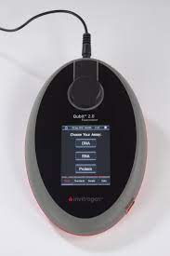
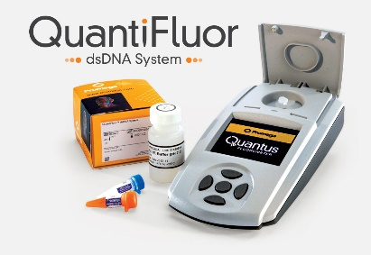
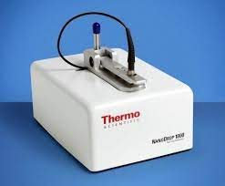
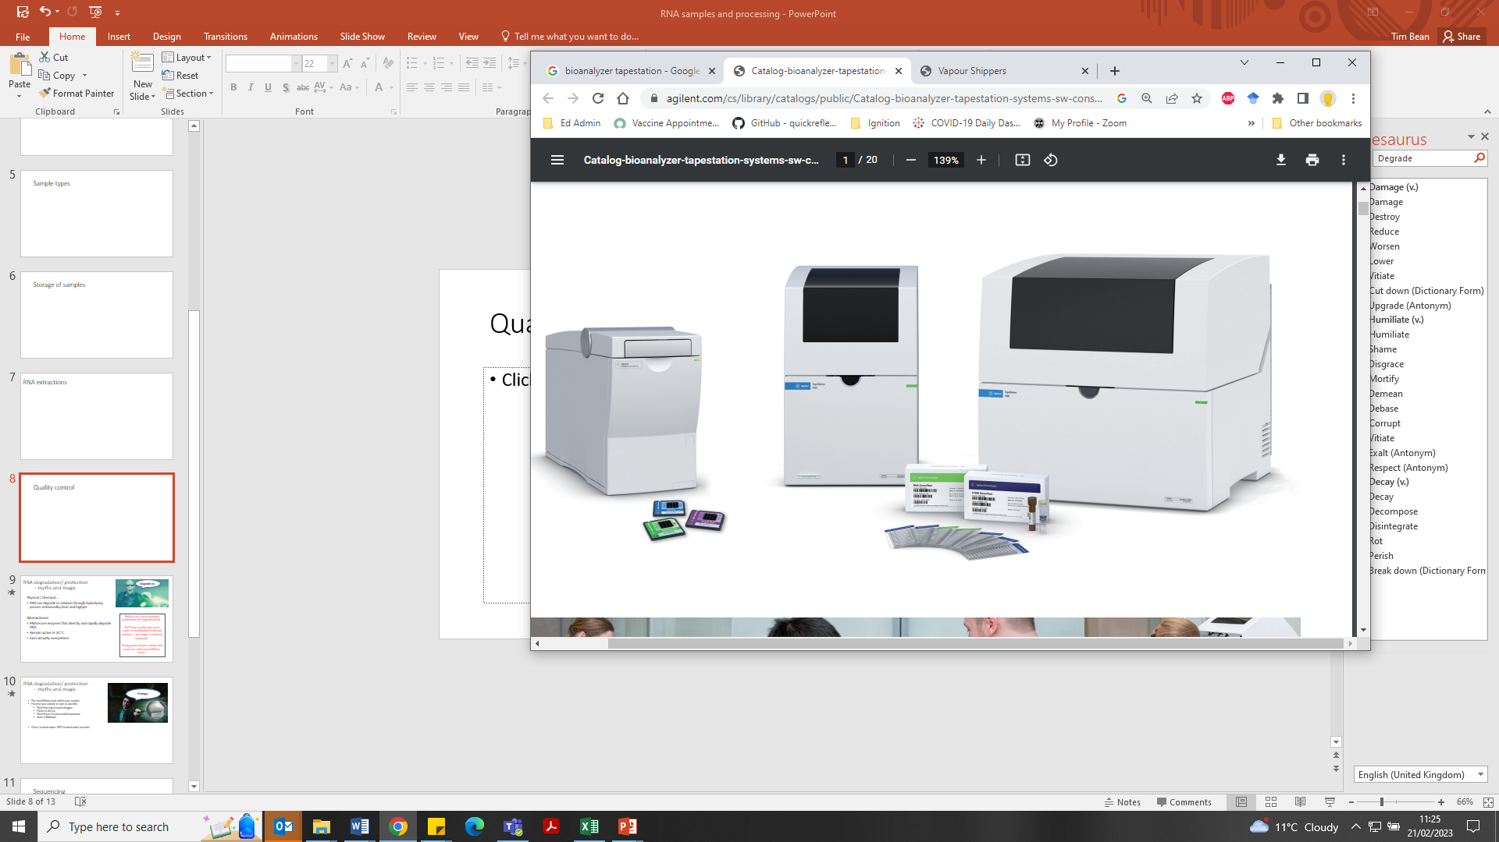
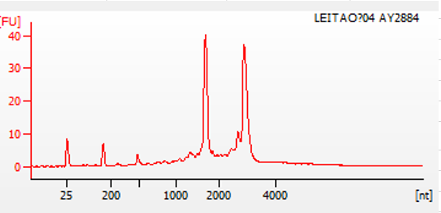
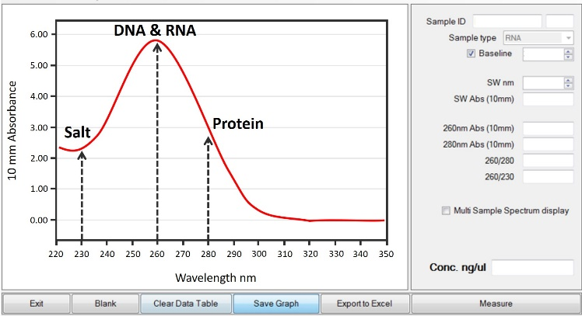
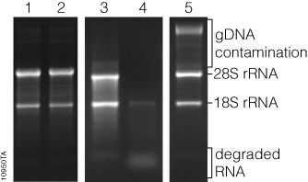
Quality control
Check quantity and purity with Nanodrop or other spectrophotometer.
Confirm quantity with fluorescent methods (Qubit, Quantifluor)
Check RNA integrity with capillary electrophoresis (Bioanalyzer, Tapestation)
Consistency across an experiment is usually the most important factor.
Discard or take note of samples which do not behave as expected.
260/280 ~2.0
260/230 ~2.0 – 2.2
For Stranded mRNA-Seq RIN>8
500 ng to 1ug total RNA required per sample.
NOTE – Some species (drosophila, bivalves) only show one RNA band

Slide 14
Nanodrop (Spectrophotometer)
Nanodrop measures absorption of light at different wavelengths from 220 to 350 nm.
Nucleic acids absorb light at 260 nm (all nucleic acids... Not just RNA).
Used for quantification and to check for contamination.
To quantify nucleic acid take the absorption at 260 x 50 for DNA or Ab260 x 40 for RNA.
Use all the information available to you... Not just the number in the bottom right!

Slide 15
Dye based... Invitrogen Qubit / Promega Quantus / RiboGreen
Very accurate quantification.
Distinguishes between nucleic acid types.
Measures against a standard (make up fresh standards for important experiments!)
Cannot spot contamination
Qubit measures fluorescence of dyes which bind to specific nucleic acids
dsDNA Broad Range (BR)
dsDNA High Sensitivity (HS)
ssDNA Assay Kit
RNA High Sensitivity (HS)
RNA Broad Range (BR)
RNA Extended Range (XR)
MicroRNA kit
Quantification more accurate that nanodrop or tapestation
Differences between qubit and nanodrop can be down to contamination and vary a lot depending on the extraction method used.
(Promega Quantus is very similar and usually cheaper.)

Slide 16
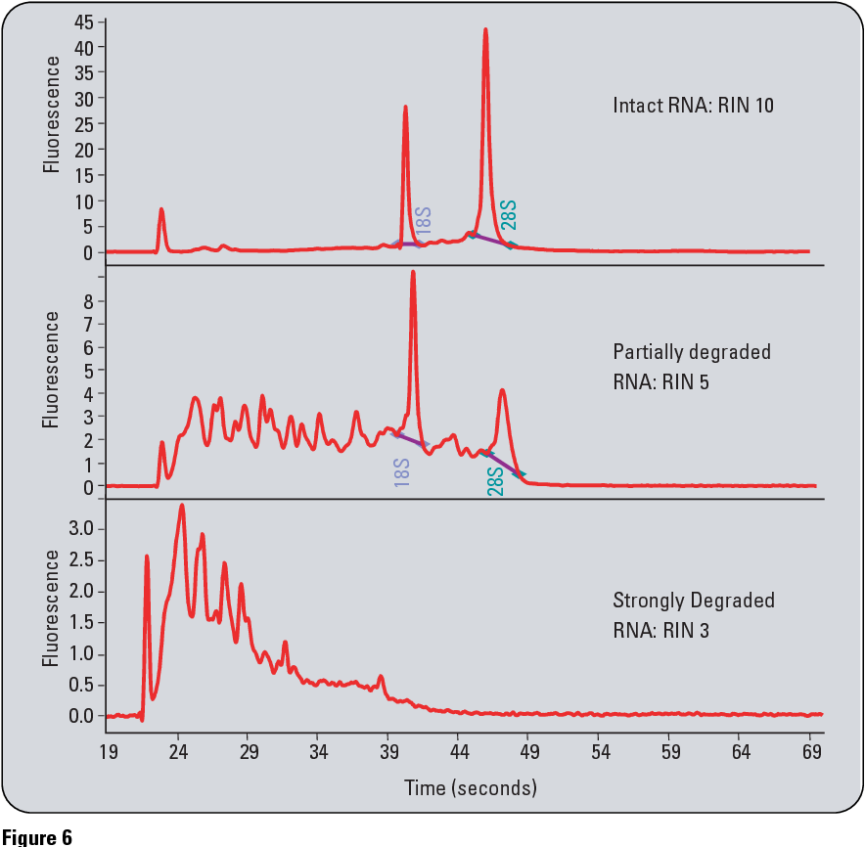
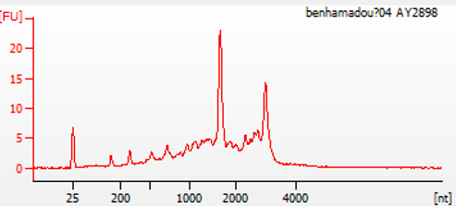
Bioanalyzer / Tapestation (Capillary electrophoresis)
Generally use the “high Sensitivity RNA Protocol” to assess RNA Integrity Number (RIN).
RIN is calculated by the ratio of large to small RNAs, measuring degredation.
Most sequencing providers are delighted with a RIN>8 but can work with much lower if required
Sequencing companies will usually insist on running this QC for you.
Good quality (normal) trace
DNA contamination
Less RNA with some degradation
*Note... Some invertebrates (e.g. bivalves) only show one RNA band... The 28S rRNA breaks into two that are the same size as the 18S rRNA. The Tapestation will still calculate a RIN as normal but it is not visible on a gel / trace.

Slide 17
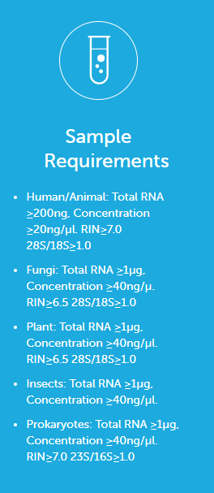
Novogene
BGI

Slide 18

Library Preparation – Choices...
It is possible to prepare your own libraries and send for sequencing.
However, it is easier, cheaper and more reliable to use a service provider.
Aim of sequencing (transcriptome, quantitative gene expression, lcRNA, micro RNA)
Total or mRNA sequencing
Type of rRNA depletion
Strandedness
Poly A selection or 3 prime biased sequencing.

Slide 19

Library Preparation – rRNA
The majority of RNA in a cell is rRNA... This is of little to no interest for most RNAseq experiments.
Two ways to deal with this...
rRNA depletion – removal of rRNA from the sample total RNA-seq.
Illumina: TruSeq
Probes hybridize rRNA on magnetic beads
RNA of interest remains in supernatant
RiboErase (or equivalent)
Probes hybridize rRNA in solution
Hybrids are digested with RNase H
Probes digested with DNase I
NOTE – efficiency of rRNA removal may vary between species / samples
mRNA enrichment – mRNA-seq
Selective reverse transcription of mRNA using either OligodT primed RT OR polyA selection

Slide 20

Library Preparation – rRNA
For differential gene expression analysis, it is best to enrich for Poly(A)+ (unless you are aiming to obtain information about long non-coding RNAs), but ribosomal RNA depletion is also very common.
Noting... Poly A selection also depletes...
Ribosomal/Transfer RNA
Histone mRNA
Long-noncoding RNA
Nascent intron containing transcripts
Micro RNA
Degraded RNA
Many viral transcripts
Most prokaryote transcripts

Slide 21
Library Preparation
For differential gene expression analysis, it is best to enrich for Poly(A)+, unless you are aiming to obtain information about long non-coding RNAs, then do a ribosomal RNA depletion.
Test your sample storage and extraction method prior to any large-scale experiment.
Determine the quantity and quality of your sample.
Note special requirements for experiment
Decide if you are performing mRNA-seq or rRNA depletion
Oligo(dT) RT also depletes...
Ribosomal/Transfer RNA
Histone mRNA
Long-noncoding RNA
Nascent intron containing transcripts
Micro RNA
Degraded RNA
Many viral transcripts
Most prokaryote transcripts

Slide 22
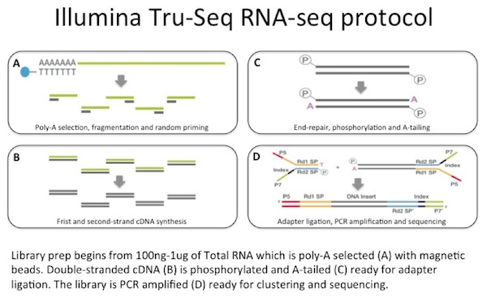
Library Preparation – Illumina TruSeq...
Tru-Seq is poly-A selection. 3’ biased sequencing is similar... But primes off poly A rather than with random primer.

Slide 23
Library Strandedness
Can be useful for certain applications ( ) but costs more.

Slide 24
Library Strandedness

Slide 25
Library Preparation – Barcoding
Now a standard part of library prep – allows multiplexing of large numbers of samples.

Slide 26
Library Preparation – Final QC

Slide 27

On to the sequencing (the easy bit)...

Slide 28
Title

Slide 29
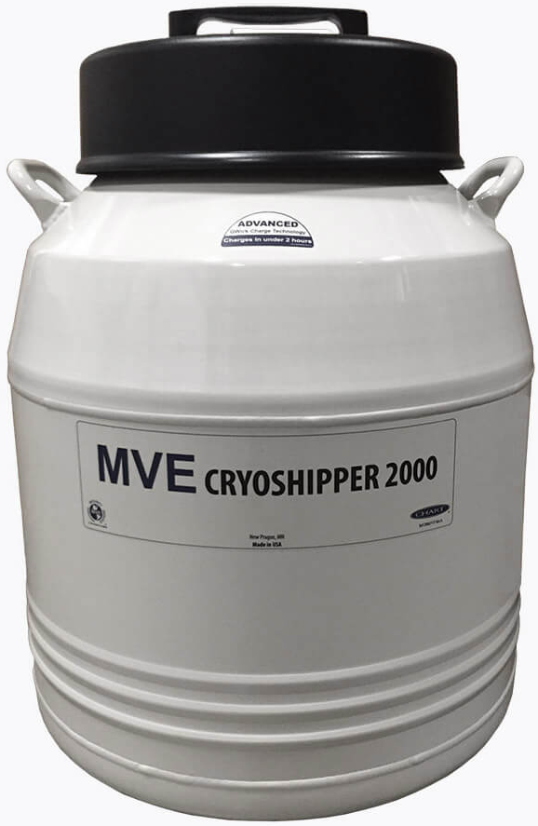

Other thoughts...
Logistics of posting RNA or samples...
Frozen Samples can be sent on dry ice or dry shippe
RNAlater samples can be sent frozen, chilled, or if required at room temp for short trips. Where possible avoid freeze thaw cycles. Always have test samples.
Purified RNA needs to be sent either on dry ice, or using a vapour (dry) shipper
If shipping overseas... World courier are expensive but by far the safest
Long term storage of RNA requires different techniques
RNA can be stored at -80 for several years but will eventually degrade.
Can be stored in liquid nitrogen for longer
For long term storage, precipitate RNA (with Acetate and ethanol) and store RNA pellet on ethanol at -80

Slide 31
RNA gel loading buffer
Reagent | Quantity (for 10 mL of 1.5×) | Final concentration
Formamide, ultrapure | 9.5 mL | 95%
Bromophenol blue (2.5%, w/v) | 100 µL | 0.025%
Xylene cyanol FF (2.5%, w/v) | 100 µL | 0.025%
EDTA (0.25 M, pH 8.0) | 200 µL | 5 mM
Use 5 µL for a 2.5-μL sample. Purchase a distilled, deionized preparation of formamide and the above loading dyes. Store in small (1-mL) aliquots for up to 1 yr at −20°C. This solution is available commercially (Ambion) and is recommended over homemade.

